Slide 1
2015 National Conference on the Administration of the NCAE, PEPT and TEPT-PST
Dr. NELIA V. BENITO, CESO IV
Director III

Slide 2
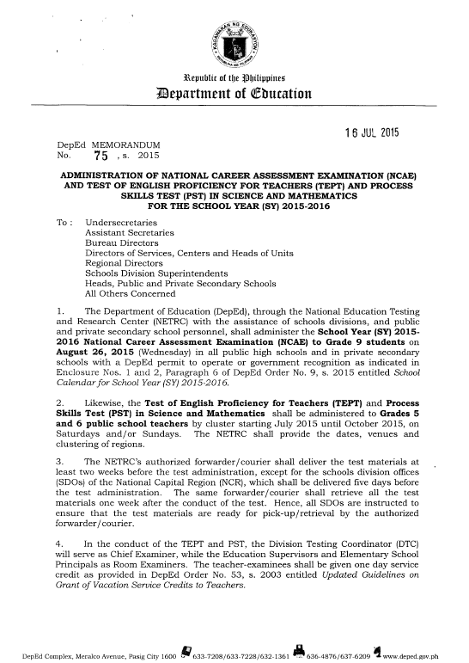
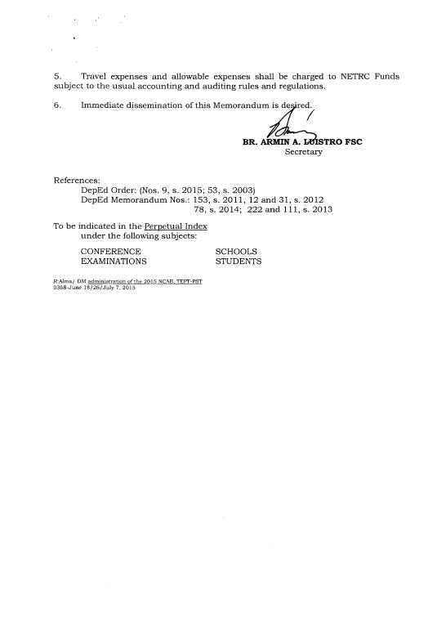
Memo - Administration

Slide 3
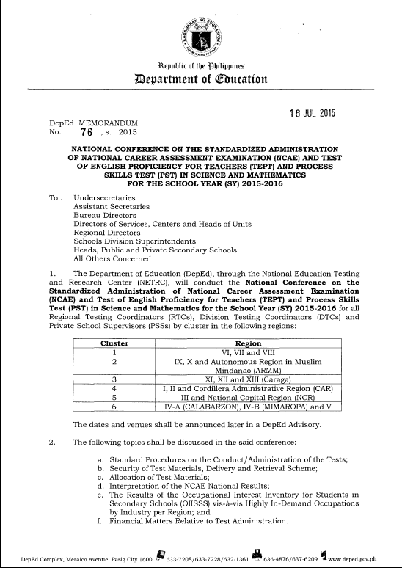
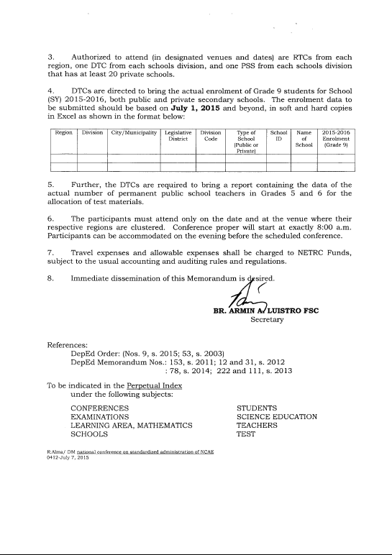
Memo - Conference

Slide 4
1. What is the NCAE?
NCAE = National Career Assessment Examination
It is an aptitude test geared toward providing information through test results for self-assessment, career awareness and career guidance of junior high school students of the K to 12 Basic Education Program (BEP).
Test-taking is mandatory.
Test results are recommendatory.
For K to 12 Program: career guidance for choosing the tracks in Senior High School
4

Slide 5
2. What other features characterize the NCAE?
A locally developed test which was standardized and validated using Filipino respondents
A paper-and-pencil test which utilizes scannable answer sheets that are processed electronically
A multiple-choice type of test
Culture fair and sensitive
Provides an end-user-friendly report format (COR)
5

Slide 6
3. Why was NCAE developed?
The NCAE was developed to:
To foster the highest quality of education in the Philippines by regulating and monitoring the flow of students to post secondary institutions of learning and their potential contribution to national development
To minimize indiscriminate wastage of manpower and resources by working for a match between manpower skill outputs and job market demands
6

Slide 7
4. What are the specific objectives of the NCAE?
To assess the skills of Grade 9 students planning to proceed to senior HS, toward providing relevant information on their skills, abilities and readiness for academic and non-academic courses;
To provide information that will help high school students make wise career decision; and
7

Slide 8
5. How is NCAE different from NCEE?
Similarities | Differences
Both are general scholastic aptitude tests (GSAT) | NCAE includes scientific ability as an area in GSAT Still recommendatory – without cut-off score Includes technical-vocational aptitude, logical reasoning ability, occupational interest inventory, aptitude on academic tracks
8

Slide 9
6. Who are the target examinees of the NCAE?
All enrolled Grade 9 students in public and private high schools operating with permit
9

Slide 10
2015 NCAE - Occupational Interest Inventory for Students in Secondary Schools (OIISSS)
Clusters of Occupational Fields*
Science
Natural Sciences
Aquaculture and Agriculture/Forestry
Engineering
Business and Finance / Commerce
Professional Services
Personal Services
Computers and Technology
Media and Communication
Community Services
Architecture and Construction
The Arts
Fashion: Garments, Hairstyle/Cosmetics/Parlor Services, Jewelry and Accessories
Military and Law Enforcement
Spiritual Vocation
* As per consultation with Dr. Annadaisy J. Carlota, Consultant, Department of Psychology, UP Diliman (2014)
10

Slide 11
7. What are the domains measured in the NCAE?
A. General Scholastic Aptitude (GSA) – 155 items
  Scientific Ability (SA) ------------------------------------------------40 items
  Reading Comprehension (RC) ------------------------------------- 30 items
  Verbal Ability (VA) ----------------------------------------------------30 items
  Mathematical Ability (MA) ----------------------------------------- 40 items
  Logical Reasoning Ability (LRA) __________________________ 15 items
Occupational Interest Inventory for
Students in Secondary Schools (OIISSS) ----------------------------------- 215 items
C. Aptitude for Academic Tracks _150 items*
  Humanities and Social Sciences (HUMSS) _______________________50 items
  Science, Technology, Engineering and Math (STEM)_______________50 items
  Accountancy, Business and Management (ABM) __________________50 items
D. Technical-Vocational Aptitude (TVA) ____________________________ 60 items
*Revised 2014
11

Slide 12
Occupational Interest Inventory of Students in Secondary Schools (OIISSS)
This is an inventory / checklist of occupational interests which provides an assessment on inclinations / preferences for comprehensive career guidance.
The students are provided with a profile chart of their occupational inclinations and preferences thru the identified cluster occupations.

Slide 13
8. What information is derived from the NCAE COR?
COR = Certificate of Rating
The COR contains the report on how the examinees performed in the test which is presented in a graph alongside the Standard Scores and Percentile Ranks.
The descriptive rating of the Percentile Rank is also included.
The overall GSA and TVA scores are reported along with scores in the subtests.
The GSA score is the average of the standard scores in these areas: SA, RC, VA, MA and LRA.
13

Slide 14
Reporting of results for HUMSS, STEM and ABM will be in Standard Score and Percentile Rank.
Likewise, the TVA score is the composite of the CA and VMS scores.
OIISSS: The level of preference for each area of occupational interest is displayed based on percentage score which is as follows: high (76-100), moderate (51-75), low (26-50) and very low (0-25)
Examinees can gauge their individual strengths and weaknesses in every domain/area measured based on the test results.
14

Slide 15
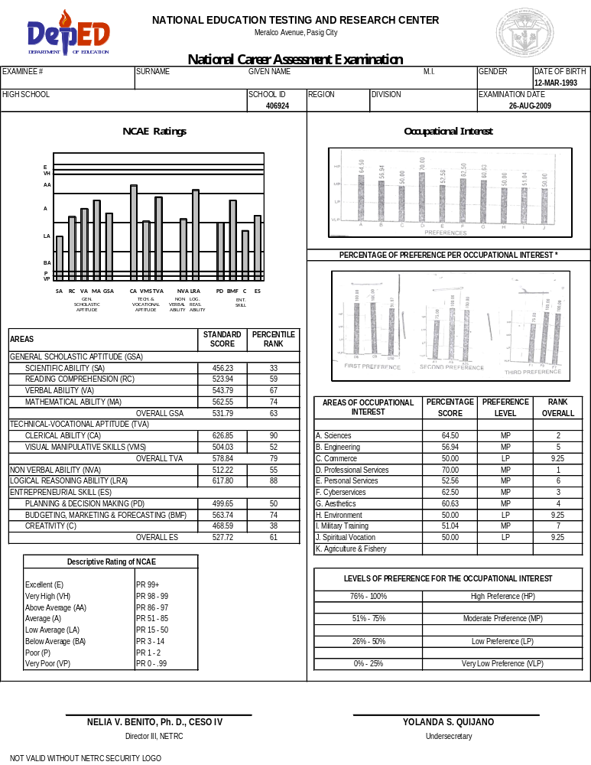
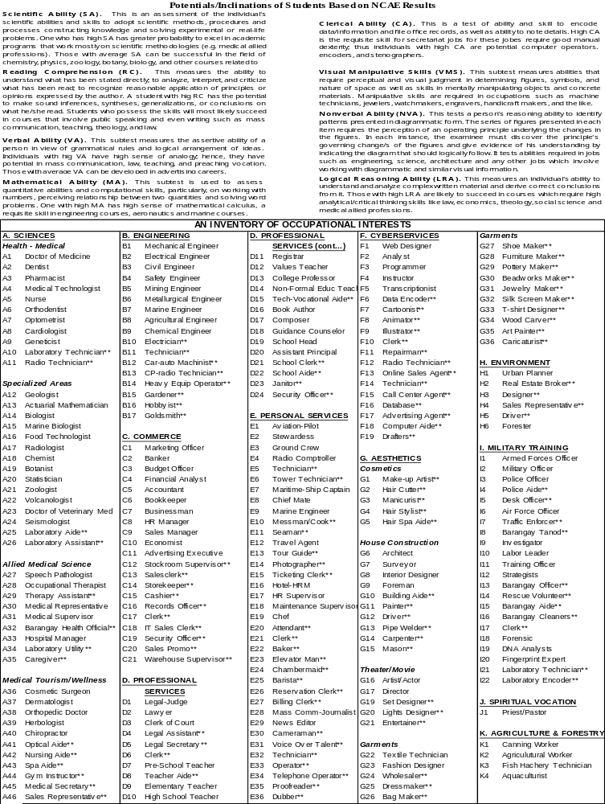
Facsimile of the NCAE COR (2012)
FRONT BACK
TDPU-pjdc/7/16/12
15

Slide 16
9. How are the NCAE scores reported and interpreted?
The scores are reported in Standard Scores and Percentile Ranks.
Standard Score - where the mean is 500 and the standard deviation is 100. The highest scores are in the 700’s; the lowest scores are in the 300’s.
Percentile Rank - shows the test taker’s position among all the examinees. If an examinee scores at percentile rank 99+, it means that he scored above the other 99 percent of the examinees.
16

Slide 17
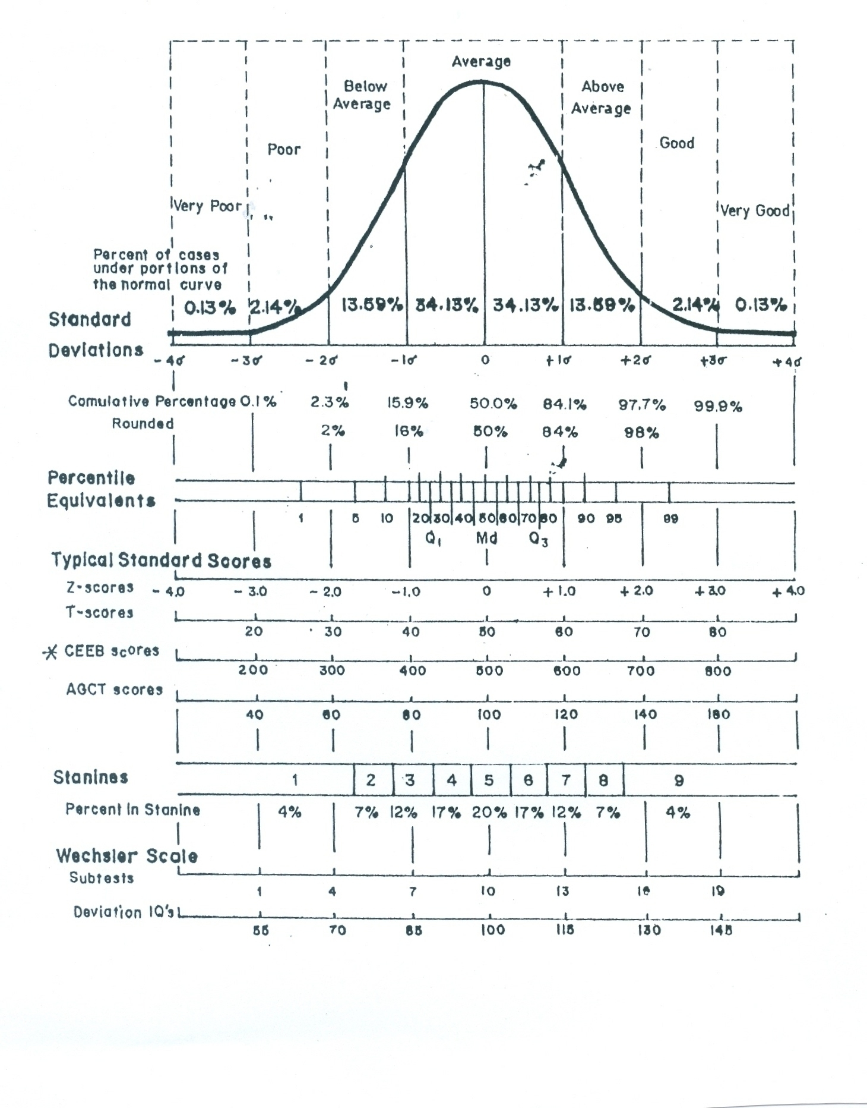
Sample Plot of a Percentile Rank (PR) in a Normal Curve
X
PR = 80
17

Slide 18
12. Is there a testing fee required in taking the NCAE?
None.
The cost in the preparation of test materials and administration of the test does not entail any amount from the schools, parents and students.
All expenses are shouldered by the Department.
18

Slide 19
How long does it take for an examinee to receive
his/ her individual COR (test results)?
3-4 months
19

Slide 20
How will the NCAE guide high school students and their parents
in determining the career track they should take?
The NCAE intends to provide information that will help high school students make wise career decisions based on the results of the domains of the test.
It also provides an interest inventory that will show the inclinations of the students in a particular occupational field.
The test results will validate the previously thought career choice by showing the student’s strengths and weaknesses in the aforementioned domains.
20

Slide 21
15. How has the general public responded to the results of the exam? Are parents
willing to follow the test results for their children’s career plans?
In 2007, DepED-NETRC conducted a survey on the utilization of the NCAE results for SY 2006-2007.
Nineteen (19) higher education institutions and TESDA accredited schools in twelve (12) schools divisions participated in the survey.
The NCAE annual administration was viewed positively by 81.31% of the students.
80% of their parents affirmed in the necessity to administer the NCAE yearly.
21

Slide 22
85% of the school officials favored the annual administration of the NCAE.
Across the four groups of respondents (students, parents, school officials and CHED/TESDA institutions), the NCAE elicited high acceptance level.
All groups manifested agreement on the yearly administration of the NCAE.
22

Slide 23
Based on the results of the test, what are the policy directions of
DepED on the basic education curriculum?
Policy Directions:
Based on the results of the NCAE over the years, majority of our high school graduates have inclinations toward technical-vocational (tech-voc) occupations.
The strengthening of 261 technical-vocational high schools is being carried out by the Department wherein improvements are being made in their curriculum, training, physical and policy support.
23

Slide 24
The results validate DepED’s decision to put great stress on tech-voc program, that is, to equip high school students with technical-vocational skills that can empower them to find meaningful employment, whether or not they pursue college education.
DepED’s tech-voc curriculum is being aligned with the training regulations of TESDA. This will allow tech-voc high school graduates to acquire TESDA certificates.
It is also the Department’s goal to improve the abilities of students in the general scholastic domain.
24

Slide 25
Moreover, the Department is currently working on intensifying the career guidance programs in public national high schools and in orienting the guidance staff in the schools and division offices on how to maximize the utilization of the NCAE results in order to properly guide students in making wise career decisions.
25

Slide 26
17. How can the results of the exam help solve the problem of job
mismatch?
With the results of the NCAE, the students will be directed to occupational fields where they would be potentially productive and successful.
26

Slide 27
18. Can the results of the NCAE be used in ranking schools?
No.
The results of the NCAE should NOT be used for other purposes other than career guidance.
27

